Slide 1
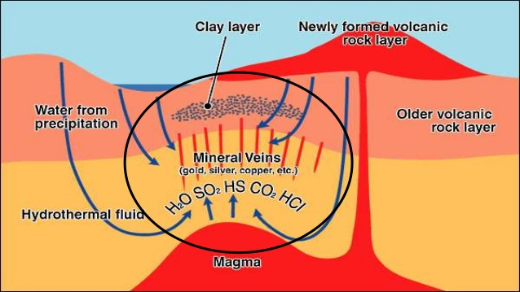
Hydrothermal deposits
Khazhiyakparova A
17-МГР(ГР)-1,5a

Slide 2
Hydrothermal mineral deposit, any concentration of metallic minerals formed by the precipitation of solids from hot mineral-laden water (hydrothermal solution). The solutions are thought to arise in most cases from the action of deeply circulating water heated by magma. Other sources of heating that may be involved include energy released by radioactive decay or by faulting of the Earth’s crust.
The mineral deposit may be precipitated from the solution with or without demonstrable association with igneous processes. These waters may deposit their dissolved minerals in openings in the rock, thus filling the cavities, or they may replace the rocks themselves to form so-called replacement deposits. The two processes may occur simultaneously, the filling of an opening by precipitation accompanying the replacement of the walls of the opening.

Slide 3
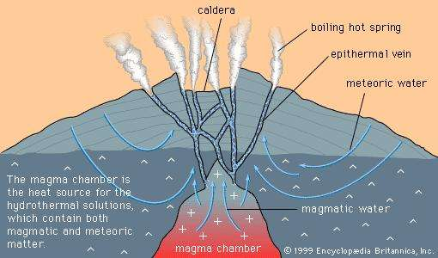

Slide 4
Conditions necessary for the formation of hydrothermal mineral deposits include presence of hot water to dissolve and transport minerals, presence of interconnected openings in the rock to allow the solutions to move, availability of sites for the deposits, and chemical reaction that will result in deposition. Deposition can be caused by boiling, by a drop in temperature, by mixing with a cooler solution, or by chemical reactions between the solution and a reactive rock. Although hydrothermal mineral deposits may form in any host rock, deposition is preferentially influenced or localized by certain kinds of rock. For example, lead-zinc-silver ores in some parts of Mexico occur in dolomitic rather than pure limestone; the reverse is true at Santa Eulalia, where massive sulfide deposits end abruptly at the limestone-dolomite contact.

Slide 5
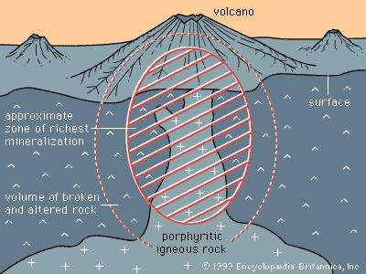

Slide 6
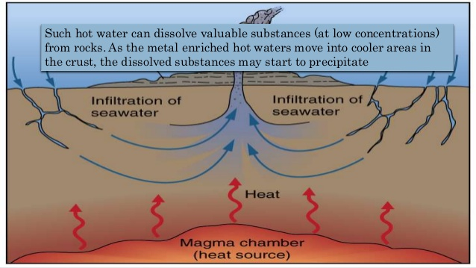

Slide 7
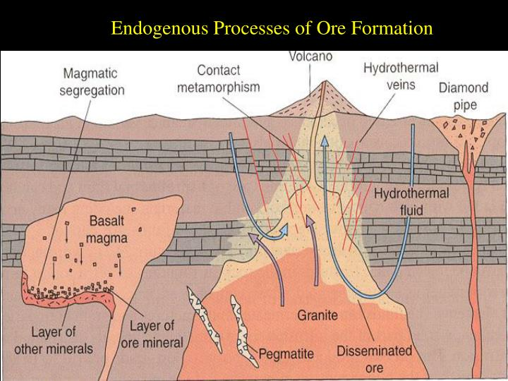

Slide 8
Thank you for your attention!

